Slide 1
CIS 5525: Neural Computation
Topic IV: Attention and Memory
Instructor: Kai Zhang
CIS @ Temple University, Spring 2020

Slide 2
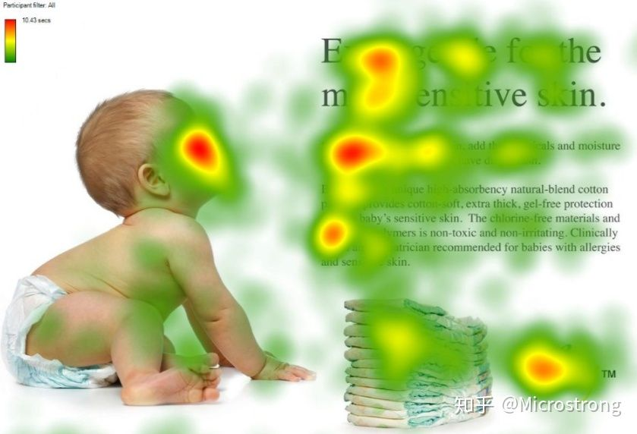

Slide 3
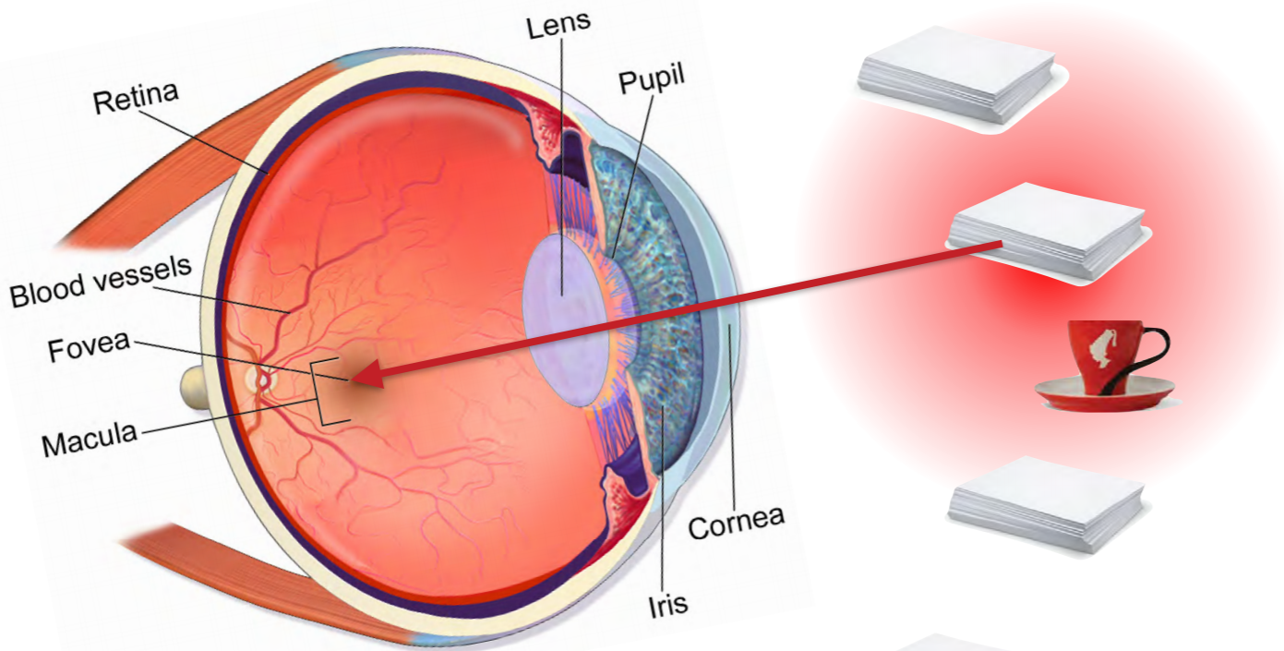
Human Visual System

Slide 4
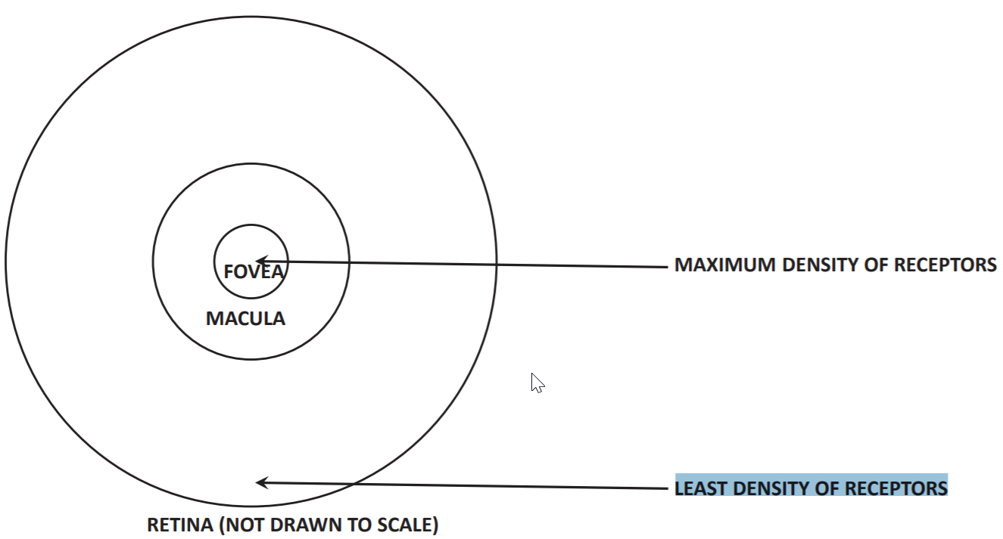
Human Attention
Resource saving
Only need sensors where relevant bits are (e.g. fovea vs. peripheral vision)
Only compute relevant bits of information (e.g. fovea has many more ‘pixels’ than periphery)
Attention in the Retina: Only a small portion of the image in the retina is carried in high resolution.

Slide 5
Attention Mechanism
Need to systematically focus on small parts of the image to find what one is looking for.
Biological organisms draw quick visual cues from whatever they are focusing on in order to identify where to next look to get what they want.
If we first focus on the door knob by chance, then we know from experience (i.e., our trained neurons tell us) to look to its upper left or right to find the street number.
Attention can often be related to sequential process
Attention is always related to memory
Memory provides a centralized (or sometimes decentralized) storage of potentially useful items for human/machine to attend

Slide 6
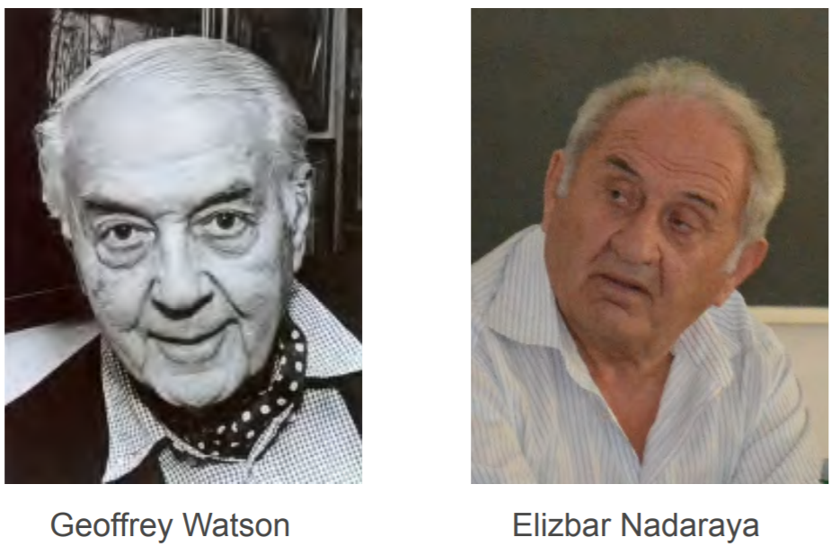
Prelude: A nonparametric Model
Watson Nadaraya Estimator (50 years ago)

Slide 7
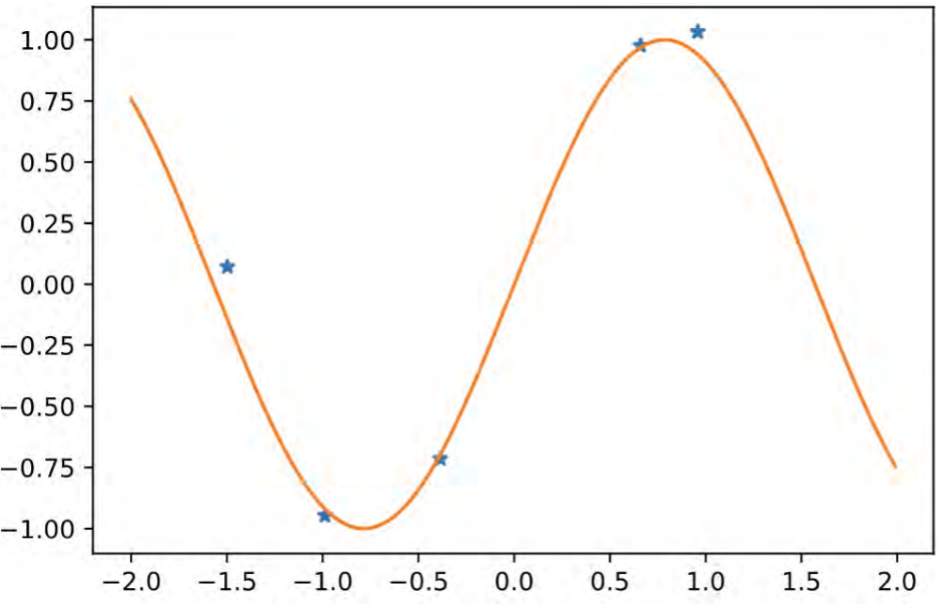
Regression Problem

Slide 8
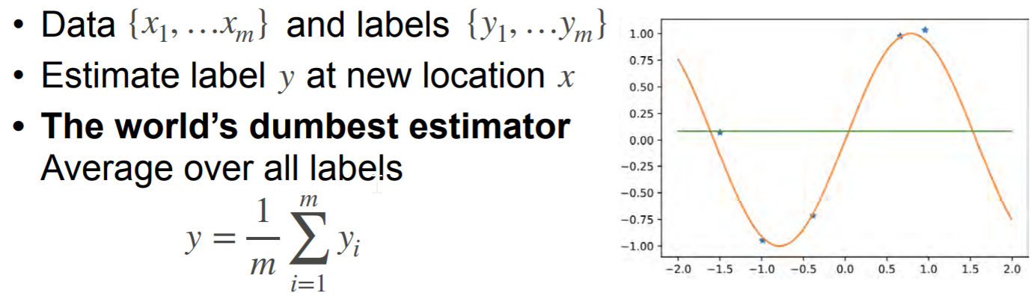
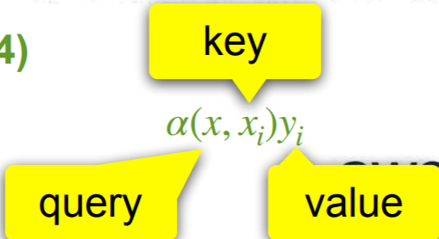
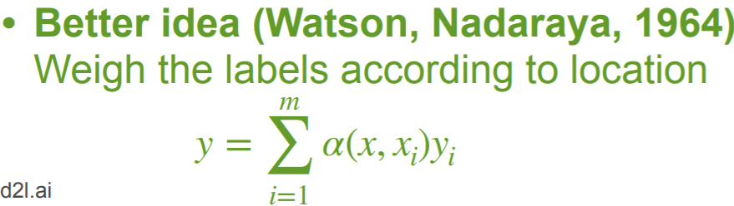
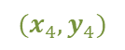
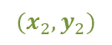
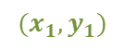

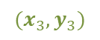
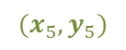
$$(x_{4},y_{4})$$
$$(x_{5},y_{5})$$
(key, value) pair
$$(x_{1},y_{1})$$
$$(x_{3},y_{3})$$
$$(x_{2},y_{2})$$
$α(x_{},x_{j})$: relatedness between x and x_j

Slide 9
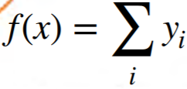
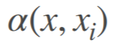
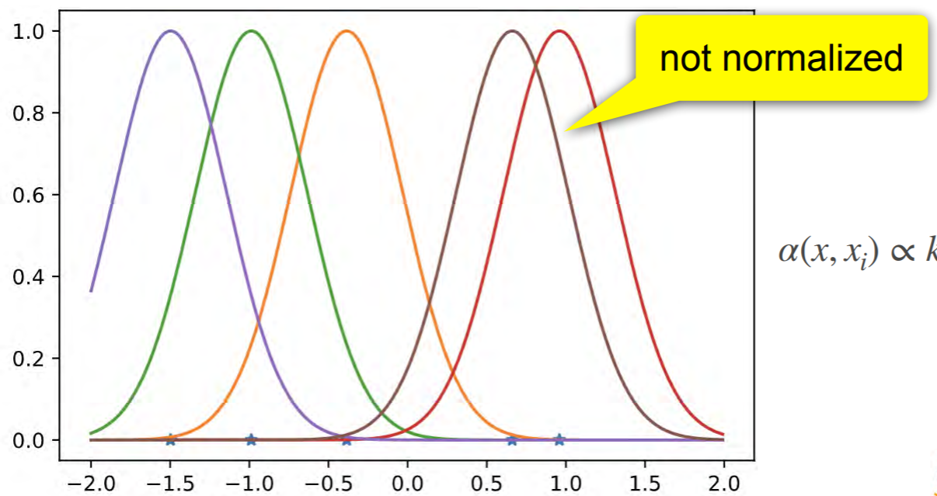
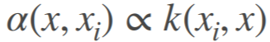
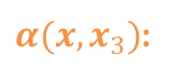
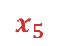
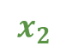
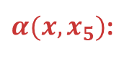
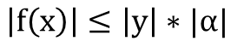
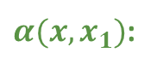
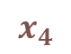
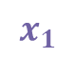
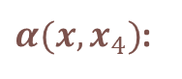
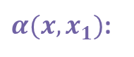
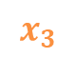
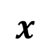
$$\left|f\left(x\right)\right|≤\left|y\right|∗|α|$$
Weighing function
$α(x,x_{1})$:
$α(x,x_{3})$:
$α(x,x_{4})$:
$α(x,x_{1})$:
$α(x,x_{5})$:
$$x_{1}$$
$$x_{2}$$
$$x_{3}$$
$$x_{4}$$
$$x_{5}$$
Is there a problem here?
$$x$$
The magnitude of f(x)’s will be a little out-of-control

Slide 10
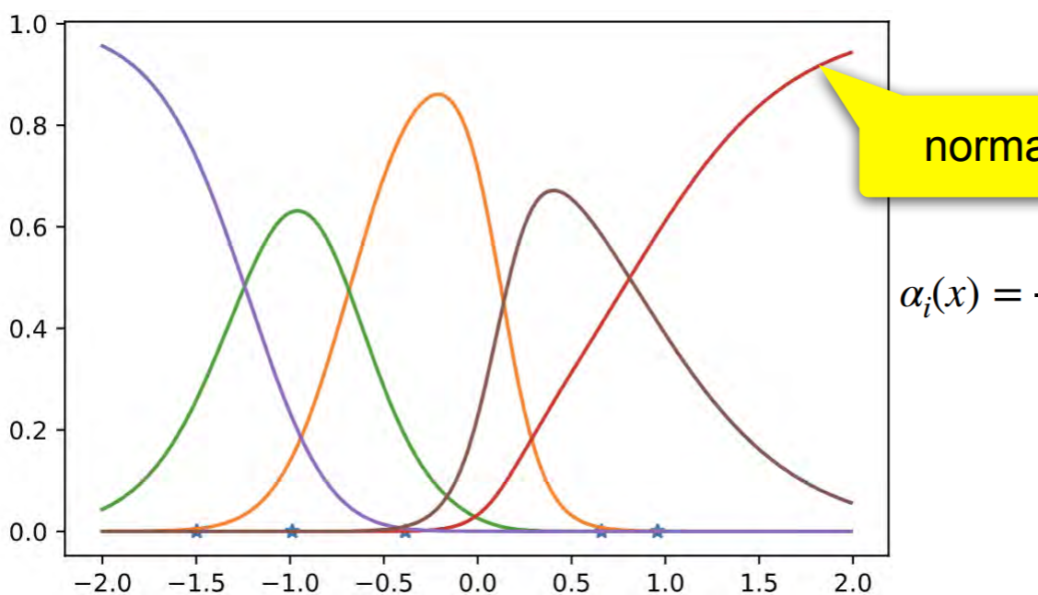
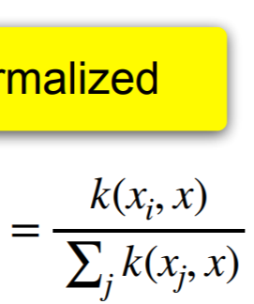
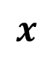
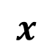
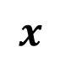
Normalized weighting!
$$x$$
$$x$$
$$x$$

Slide 11
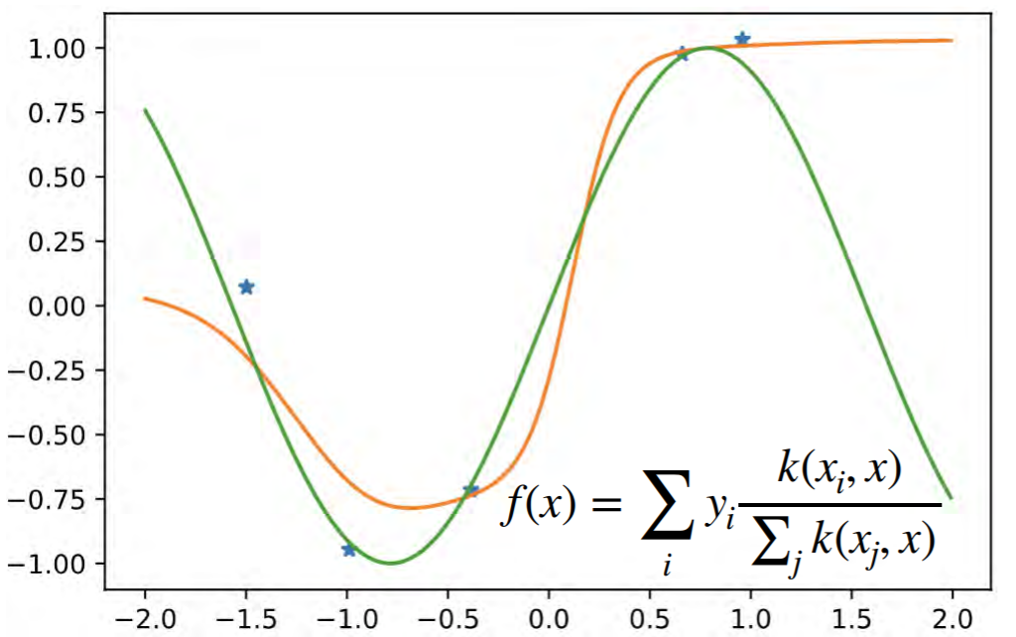
Normalized weighted regression estimate

Slide 12
What’s good about NW-Regressor
Consistency
Given enough data this algorithm converges to the optimal solution (can your deep net do this?)
Simplicity
No free parameters - information is in the data not weights (or very few if we try to learn the weighting function)
It is the earliest form of attention
And probably still the major form now with slight modifications
Learn weighting function
Replace averaging (pooling) by weighted pooling

Slide 13
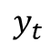

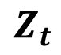
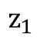
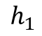
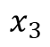
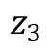
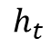
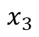
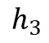
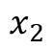
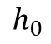
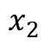
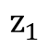
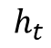
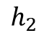

















$$x_{1}$$
$$x_{2}$$
$$x_{3}$$
hidden states
$$h_{0}$$
$$z_{1}$$
$$z_{2}$$
observed
$$h_{1}$$
$$z_{3}$$
$$h_{2}$$
$$RNN$$
$$x_{1}$$
mapped
$$h_{3}$$
$$x_{2}$$
$$x_{3}$$
prediction
$$y_{t}$$
$$h_{t−1}$$
$$h_{0}$$
$$z_{1}$$
$$h_{t}$$
$$…$$
$$z_{2}$$
$$h_{1}$$
$$h_{2}$$
$$z_{3}$$
$$Z_{t}$$
$$h_{3}$$
$$x_{t}$$
$$h_{t}$$
$$y_{t}$$
Standard RNN
$$h_{t−1}$$
$$…$$
$$Z_{t}$$
$$x_{t}$$
RNN with Attention

Slide 14




















$$x_{1}$$
$$x_{2}$$
$$x_{3}$$
$$h_{0}$$
$$z_{1}$$
$$z_{2}$$
Context
vector
$$h_{1}$$
key
$$h_{2}$$
$$z_{3}$$
$$h_{3}$$
$$h$$
context
value
$$…$$
$$h_{t}$$
$$Z_{t}$$
projected query
Essentially, attention is noting but information retrieval (or addressing)
$$x_{t}$$
query
Basic workflows for attention mechanism
Input
query vector ($q$)
Key/value vectors ($h_{i}^{′}$s)
Output
Attention scores
Combine the keys/values using normalized attention scores (aka soft attention)
With a bit abuse of notations, we may use hi’s, key’s, or even Xi’s here. Using Xi means that keys=values.

Slide 15

Attention function

Slide 16


Attention in Seq2seq models
Information bottleneck
This hidden state vector is the bottleneck
The last encoder hidden state is the bottleneck -- all information in the source sentence must pass through it to get to the decoder.

Slide 17

Learning to Pay Attention

Slide 18


Slide 19


Slide 20


Slide 21


Slide 22


Slide 23



Slide 24


Slide 25

Attention achieves the ``alignment’’ in translation

Slide 26
Proximity Measures in Attention
Evaluating the relatedness among the query and keys/values (dot product, concatenation, distance)
Feature similarity (latent space embedding): points that are close to each other (or higher inner product) are more related
Temporal relation: points temporally closer to the query time point are considered more related
Which measure should be used?
Close points (using feature based similarity) can be far away in time
Close points (using temporal relation) can be very dis-similar in terms of feature similarity
Good ways to combine the two?

Slide 27




query time point
Temporal similarity
Feature similarity
query time point
Temporal location
Temporal similarity
*
combined similarity

Slide 28




Attention Pooling
The goal of pooling is to summarize a set of items into a reduced representation
CNN pooling reduces feature map size
Attention so far is actually a kind of pooling: reducing the set of keys/values to a single context vector
Deep sets: given Sets {X₁,X₂,…}, find a permutation invariant summarization of the set.
Theorem: all functions are of the form (or some combination thereof)
Attention pooling

Slide 29

Iterative Attention (Pooling)

Slide 30


Slide 31

Visual Question Answering

Slide 32
Memory
Motivation
Attention provides a flexible framework to attend useful historical records in order to predict the future more accurately.
When making predictions, attend to the history (source, keys, ect.).
But what if we have a long history of data, say 100GB?
Repeatedly attending to the large amount of history record becomes costly
Need more effective strategies
Solution
Rather than accessing raw, unprocessed historical data, build a compact set of information source, i.e., memory.
Makes information retrieval easier.

Slide 33
Human Memory
Memory is our ability to encode, store, retain and subsequently recall information and past experiences in the human brain.
When do we recall things (even unconsciously)? Or why do we need to remember things?
When we need to take actions, make predictions, etc.
We need to learn and adapt from previous experiences
the use of past experience to affect or influence current behaviour.
Neural Basis for memory
How memory is organized, achieved and related to learning

Slide 34

End-to-End Memory Network
Networks with long-term dependencies
Attention ‘distribution’ over data points
So far specific architectures tailored to QA task
Some empirical evidence that the gradient vanishing problem or capacity limitations can be overcome by having an external memory

Slide 35


Slide 36

Self-Attention
Query and key are from the same set.
”The animal didn't cross the street because it was too tired”
”The animal didn't cross the street because it was too wide”

Slide 37

Self-Attention

Slide 38


Slide 39


Slide 40


What happens if query=key
Pairwise similarity between items (kernel matrix)
New representation for the values

Slide 41

Multi-headed Attention

Slide 42
Transformer
Attention is all you need. (Vaswani et. al 2017)
Since attention is great, why not use it for representation?
Component of Transformer
- Multi-Headed, Self-Attention
- Positional Encodings
- Residual Connections
Intuitions of Transformer
We can eliminate recurrence altogether
In encoder-decoder model, the hidden state is recurrently generatedW, which leads to sequential translation (even with attention)
Now, each output prediction word is its own “prediction problem”
Things become all parallel

Slide 43

Transformer
Self-attention in transformer: hidden states for all the words are updated in parallel

Slide 44

Encoder in Transformer
Residual
connection
Residual
connection

Slide 45


Slide 46


Positional Encoding
CNN and RNN are location sensitive because they explicitly take into account the word locations in a sentence
They process the words in certain orders
Transformer doesn’t (everything happens in parallel)
So we have to include “positional encoding”
inject some temporal information so that the model knows the relationships between words (distance & word order is important)
Examples:
Sinusoid function (periodical)
Learned positions

Slide 47

Encoder + Decoder in Transformer

Slide 48

Transformer flow

Slide 49


Slide 50
Summarization
Attention is great
Focus on relevant part, improved performance
Long-term dependency
Interpretability
Self-attention
Computational complexity (when sequence length is smaller than representation dimension)
Parallelization

